Slide 1

PROJECT 3:-Operation Analytics and Investigating Metric Spike
VARAD KHATAVKAR

Slide 2
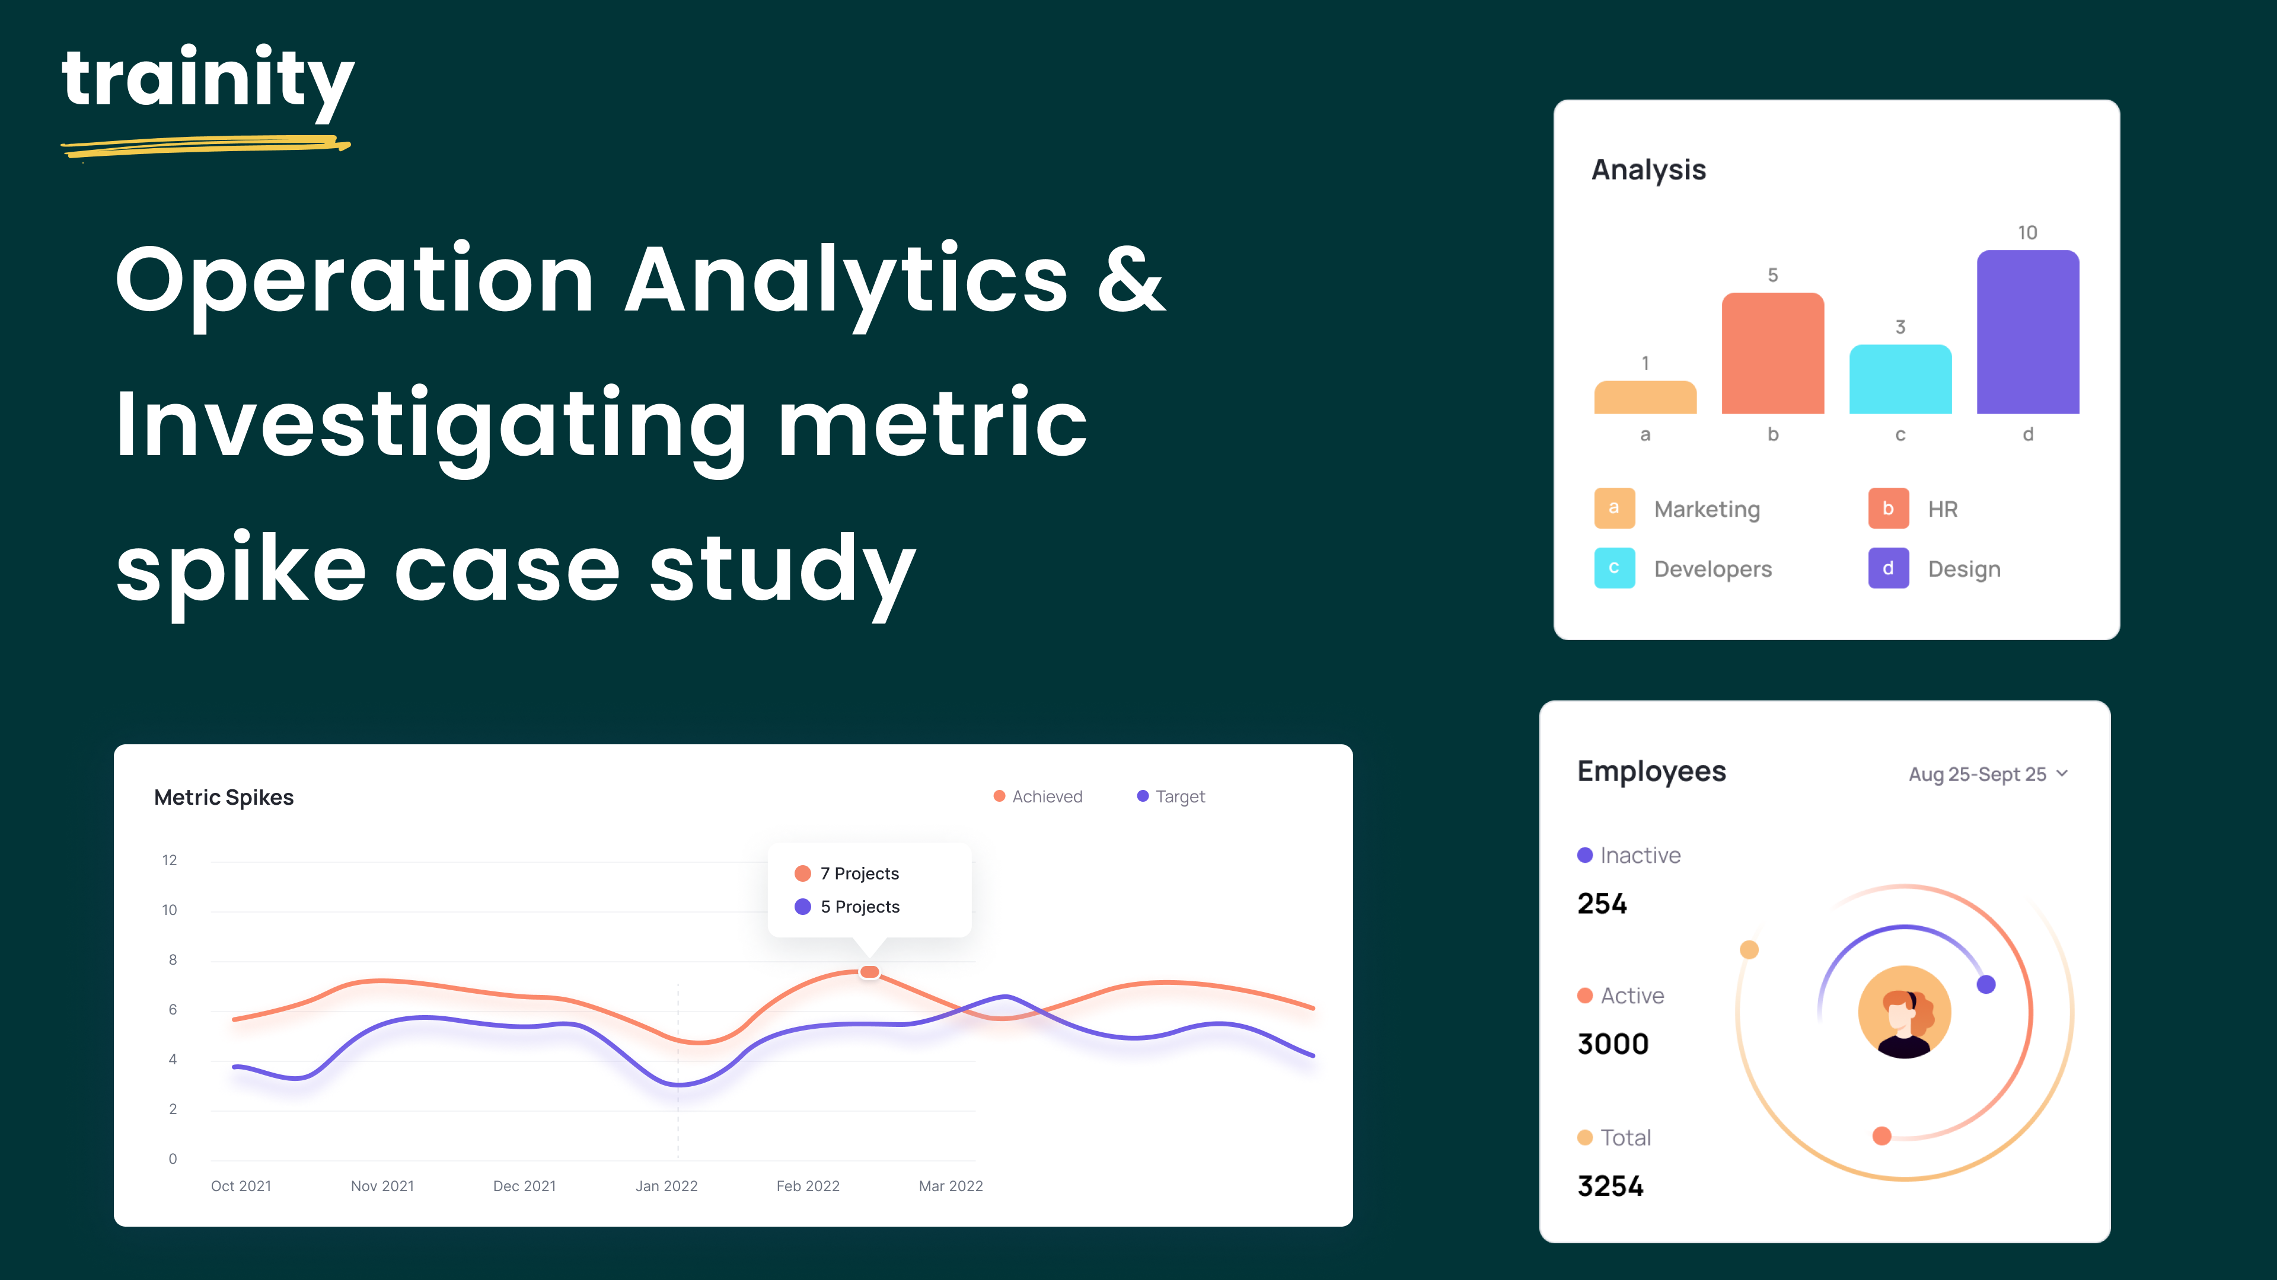

Slide 3
ABOUT THE PROJECT
This project helps identifying and investigating metric spikes along with operation analytics of the company.
Learning management of huge data sets and finding out valuable insights at an intermediate level along with table and dataset creation in larger aspects.
Use advanced MySQL skills to investigate various datasets and tables provided.
Deriving insights to be used by different departments to improve operational efficiency and understand fluctuations in key metrics.

Slide 4
PROJECT APPROACH
Examine the data, using given datasets identifying important details and gathering clues.
Identifying metric spikes and analysing the results.
Spotting the spikes(exact metric and time-frame).
Gathering clues:- Analyse the data and try to understand the reason behind the spike.
Digging deeper:- Use MySQL queries to inspect and determine results.
Display the result:- Display the obtained insights using appropriate graphs and pictures.
Tech Stack Used:-1.MySQL Command line client 8.0
2.MySQL Workbench 8.0

Slide 5

INSIGHTS

Slide 6
Case Study 1: Job Data Analysis
TASKS
Job Reviewed Over Time
Throughput Analysis
Language Share Analysis
Duplicate Rows Detection

Slide 7
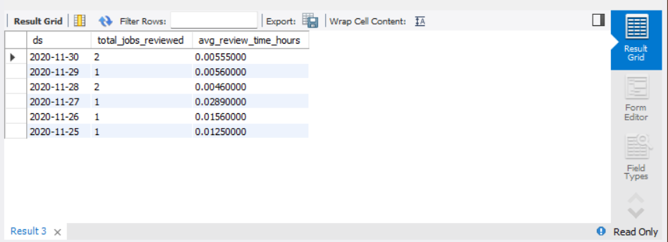
TASK A:-JOBS REVIEWED
SELECT ds, COUNT(*) AS total_jobs_reviewed, AVG(time_spent / 3600) AS avg_review_time_hours
FROM job_data
GROUP BY ds;

Slide 8
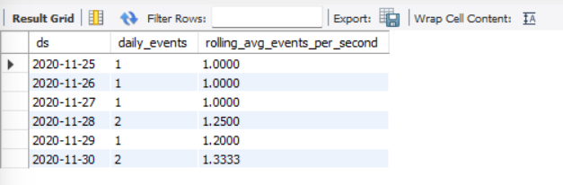
TASK B:-THROUGHPUT ANALYSIS
SELECT ds,
ROUND(COUNT(event) / SUM(time_spent), 2)
AS 'Daily Throughput'FROM job_data
GROUP BY ds
ORDER BY ds;
SELECT ds, COUNT(*) AS daily_events,
AVG(COUNT(*)) OVER (ORDER BY ds ROWS BETWEEN 6 PRECEDING AND CURRENT ROW)
AS rolling_avg_events_per_second
FROM job_data
GROUP BY ds;

Slide 9
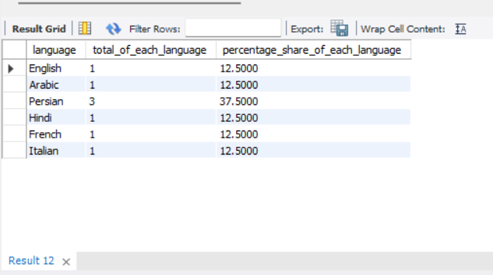
TASK C:- LANGUAGE SHARE ANALYSIS
SELECT job_data.language,
COUNT(*) AS total_of_each_language,
(COUNT(*) / (SELECT COUNT(*) FROM job_data) * 100)
AS percentage_share_of_each_language
FROM job_data
GROUP BY job_data.language;

Slide 10
TASK C:- REPRESENTATION

Slide 11
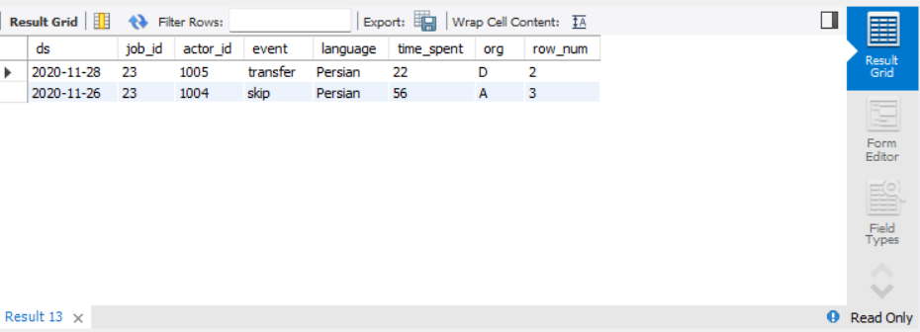
TASK D:-DUPLICATE ROWS DETECTION
SELECT *FROM
(SELECT *, ROW_NUMBER()
OVER(PARTITION BY job_id) AS
row_num
FROM job_data) a
WHERE row_num>1;

Slide 12
Case Study 2: Investigating Metric Spike
TASKS
Weekly User Engagement
User Growth Analysis
Weekly Retention Analysis
Weekly Engagement Per Device
Email Engagement Analysis

Slide 13
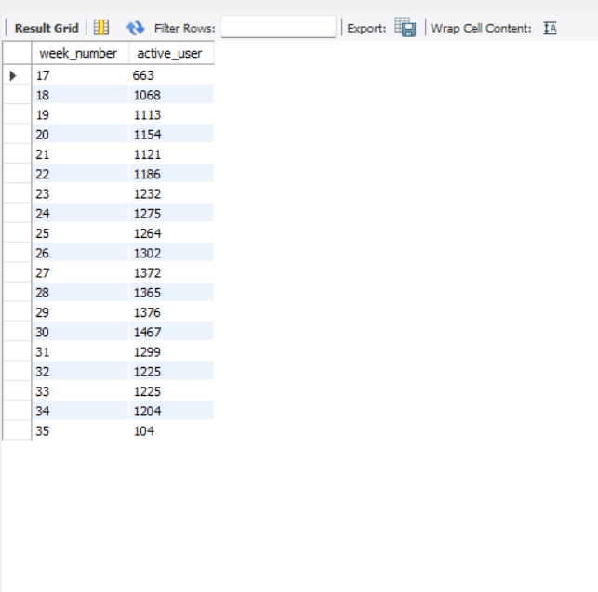
Task A:-USER ENGAGEMENT
SELECT
EXTRACT(WEEK FROM occured_at) AS week_number,
COUNT(DISTINCT user_id) AS active_user
FROM events
WHERE event_type = 'engagement’
GROUP BY week_number
ORDER BY week_number;

Slide 14
Task A:- VISUALIZATION

Slide 15
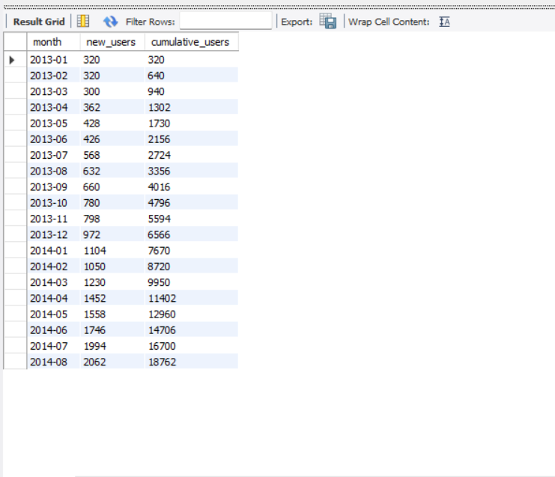
Task B:-GROWTH ANALYSIS
SELECT DATE_FORMAT(created_at, '%Y-%m') AS month,
COUNT(*) AS new_users,
SUM(COUNT(*)) OVER
(ORDER BY DATE_FORMAT(created_at, '%Y-%m’))
AS cumulative_users
FROM users
GROUP BY month
ORDER BY month;

Slide 16
Task B:-Visualisation

Slide 17
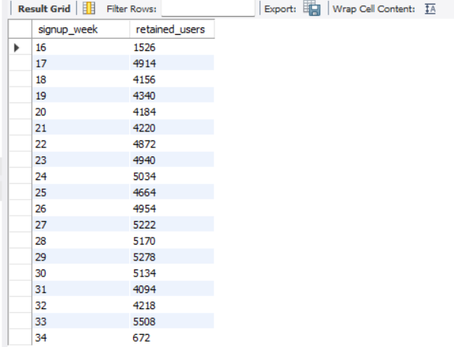
Task C:-RENTENTION ANALYSIS
WITH cohorts AS ( SELECT user_id,
WEEK(created_at) AS signup_week
FROM users)
SELECT signup_week,
COUNT(*) AS retained_users
FROM events JOIN cohorts ON events.user_id = cohorts.user_id
WHERE WEEK(events.occured_at) = signup_week + 1
GROUP BY signup_week
ORDER BY signup_week;

Slide 18
Task C:-Visualization

Slide 19
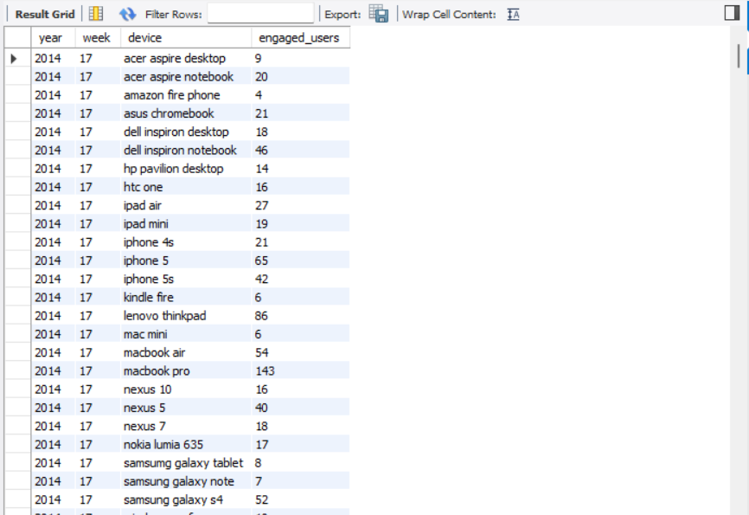
Task D:-DEVICE ENGAGEMENT
SELECT
YEAR(ev.occured_at) AS year,
WEEK(ev.occured_at) AS week,
ev.device,
COUNT(DISTINCT ev.user_id) AS engaged_users
FROM events ev
GROUP BY year , week , ev.device
ORDER BY year , week , ev.device;
*Note:-image attached is just for reference entire output is attached as drive link.

Slide 20
Task D:-Visualization
Kindly find attached output file here
https://drive.google.com/file/d/1r4mjDEt_TlTe2dSLVKwiNgrPnwID4gMh/view?usp=sharing

Slide 21
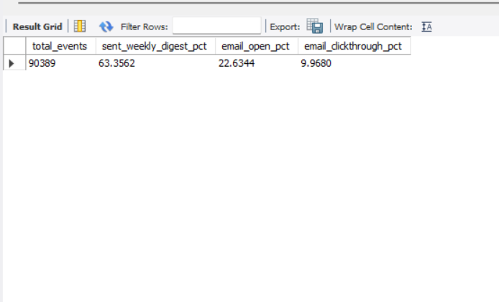
Task E:-EMAIL ENGAGEMENT ANALYSIS
SELECT
COUNT(*) AS total_events,
(COUNT(CASE
WHEN action = 'sent_weekly_digest' THEN 1
END) /COUNT(*)) * 100 AS sent_weekly_digest_pct,
(COUNT(CASE WHEN action = 'email_open' THEN 1
END) /COUNT(*)) * 100 AS email_open_pct,
(COUNT(CASE
WHEN action = 'email_clickthrough' THEN 1
END) /COUNT(*)) * 100 AS email_clickthrough_pct
FROM email_events;

Slide 22
Results
Following major results were obtained from the data visualization tools
For Case Study 1:-
Persian was discovered as language with the maximum share amongst others with 37%.
For Case Study 2:-
Week 30 had the highest count with 1467 active users.
Total count of 18762 users was achieved.
Week 33 counted highest with 5508 retained users.

Slide 23
Conclusion
This project helped me understand how to uncover data and precisely use MySQL to make most of the data available.
It also helped in understanding various concepts and variety of MySQL queries.
These concepts ranged from easy to intermediate level increasing the understanding and adaptability level.
It also helped in using various tools like Excel for data visualization.

